Slide 1
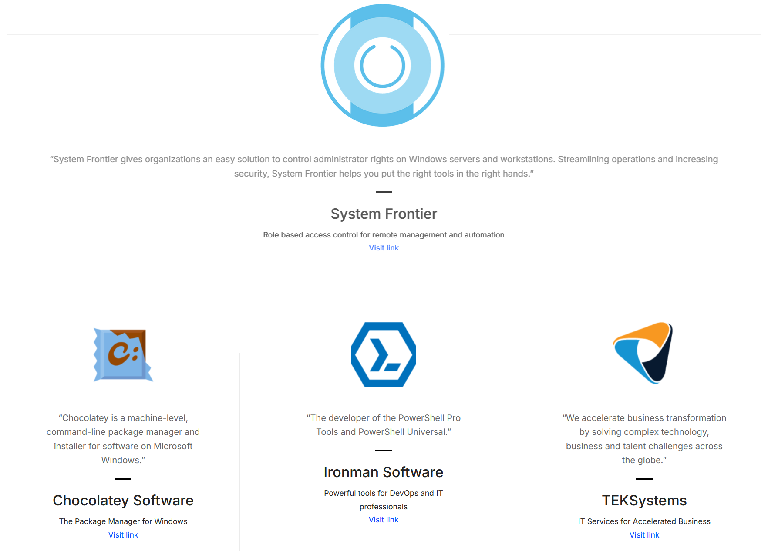



Benefits
Easier automation
Leverages multi-core systems
Faster execution
Tasks can be automated easily (sometimes - it depends) using PowerShell scripts to minimize manual intervention
Parallel execution spreads workload across multiple cores resulting in faster completion of task
Makes full use of modern multi-core systems to maximize efficiency
Parallel execution of database administration tasks using PowerShell results in significant time savings and easier automation.

Slide 2


Slide 3




About Me
Parallel DBA Tasks from the Command Line Using PowerShell
Illinois native, deeply connected to Utah
Said my first word at a St. Louis Cardinals baseball game “Charge!”
Air Force Brat
Lived in Brazil
Currently live in Raleigh, NC area
Fortunate to have a wonderful family
I love automating with PowerShell!
@nanoDBA
Notes:
automation of operational processes w/PowerShell
Yes, I am a St Louis Cardinals fan

Slide 4
Benefits
Easier automation
Leverages multi-core systems
Faster execution
Tasks can be automated easily (sometimes - it depends) using PowerShell scripts to minimize manual intervention
Parallel execution spreads workload across multiple cores resulting in faster completion of task
Makes full use of modern multi-core systems to maximize efficiency
Parallel execution of database administration tasks using PowerShell results in significant time savings and easier automation.

Slide 5

Notes:
Sometimes complex pieces ... and personalities

Slide 6
Example Tasks
Search logs
Use PowerShell cmdlets to search through database logs to identify issues or find specific events.
Query metadata
Use PowerShell to run queries against database metadata to gather information about schema, users, roles, etc
Manage SQL Server Components
Use PowerShell cmdlets to:
modify Always On Availability Groups
audit configurations
backup and restore databases in parallel
log ship

Slide 7
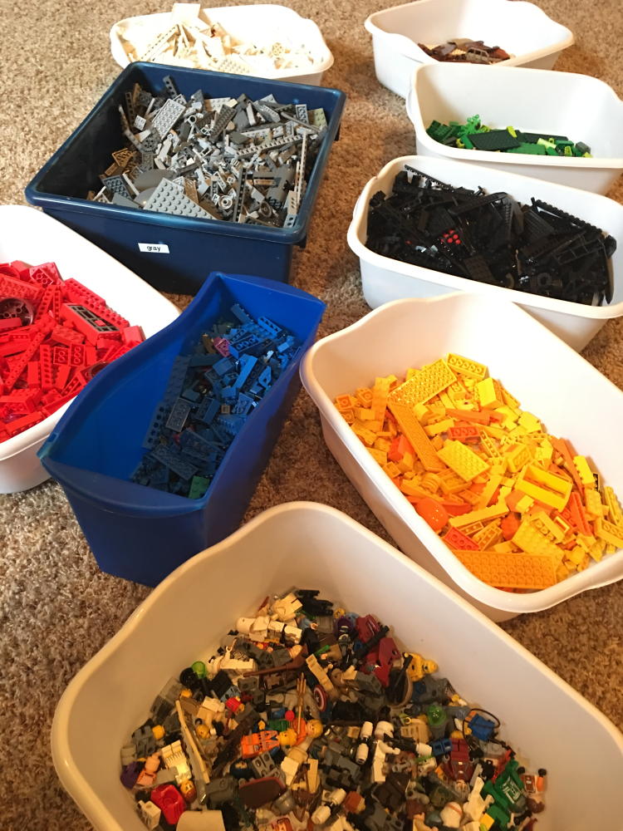
Notes:
One point being… SYSTEMS are made up of lots of pieces

Slide 8
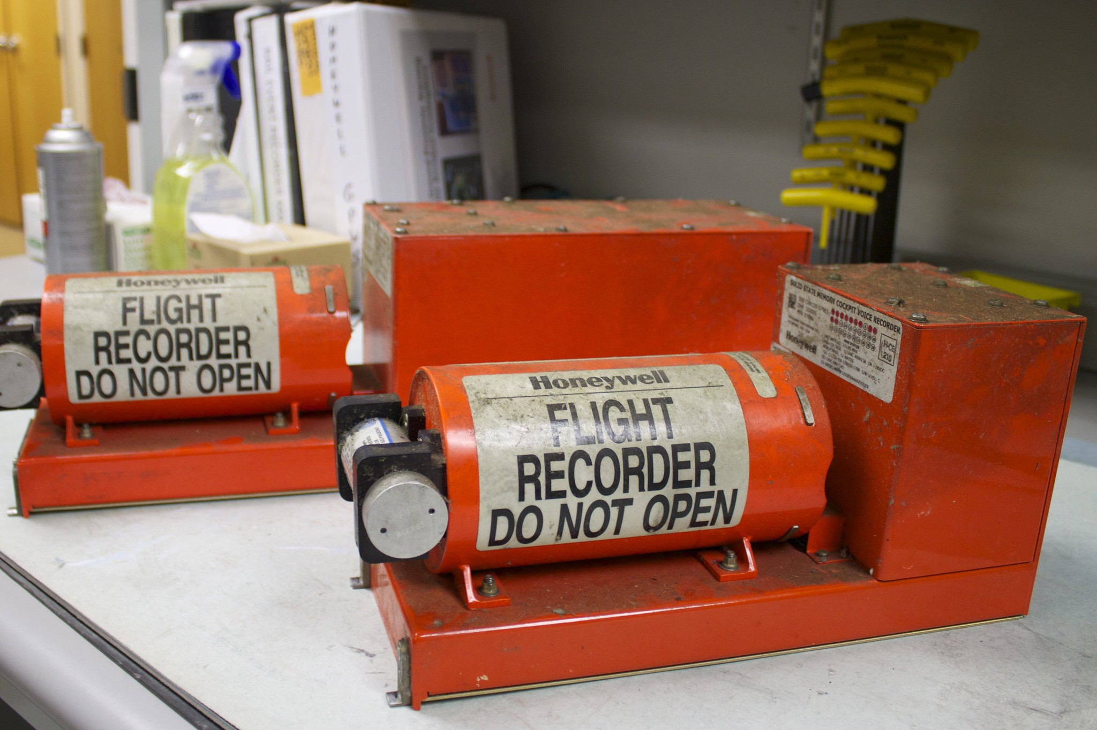
Start-Transcript Get-History
Notes:
Transcripts - PowerShell's flight recorders Start-Transcript Get-History

Slide 9

DEMO! Scripts: github.com/nanoDBA/demos gist.github.com/nanoDBA

Slide 10



Gotchas, potential dangers…

Slide 11
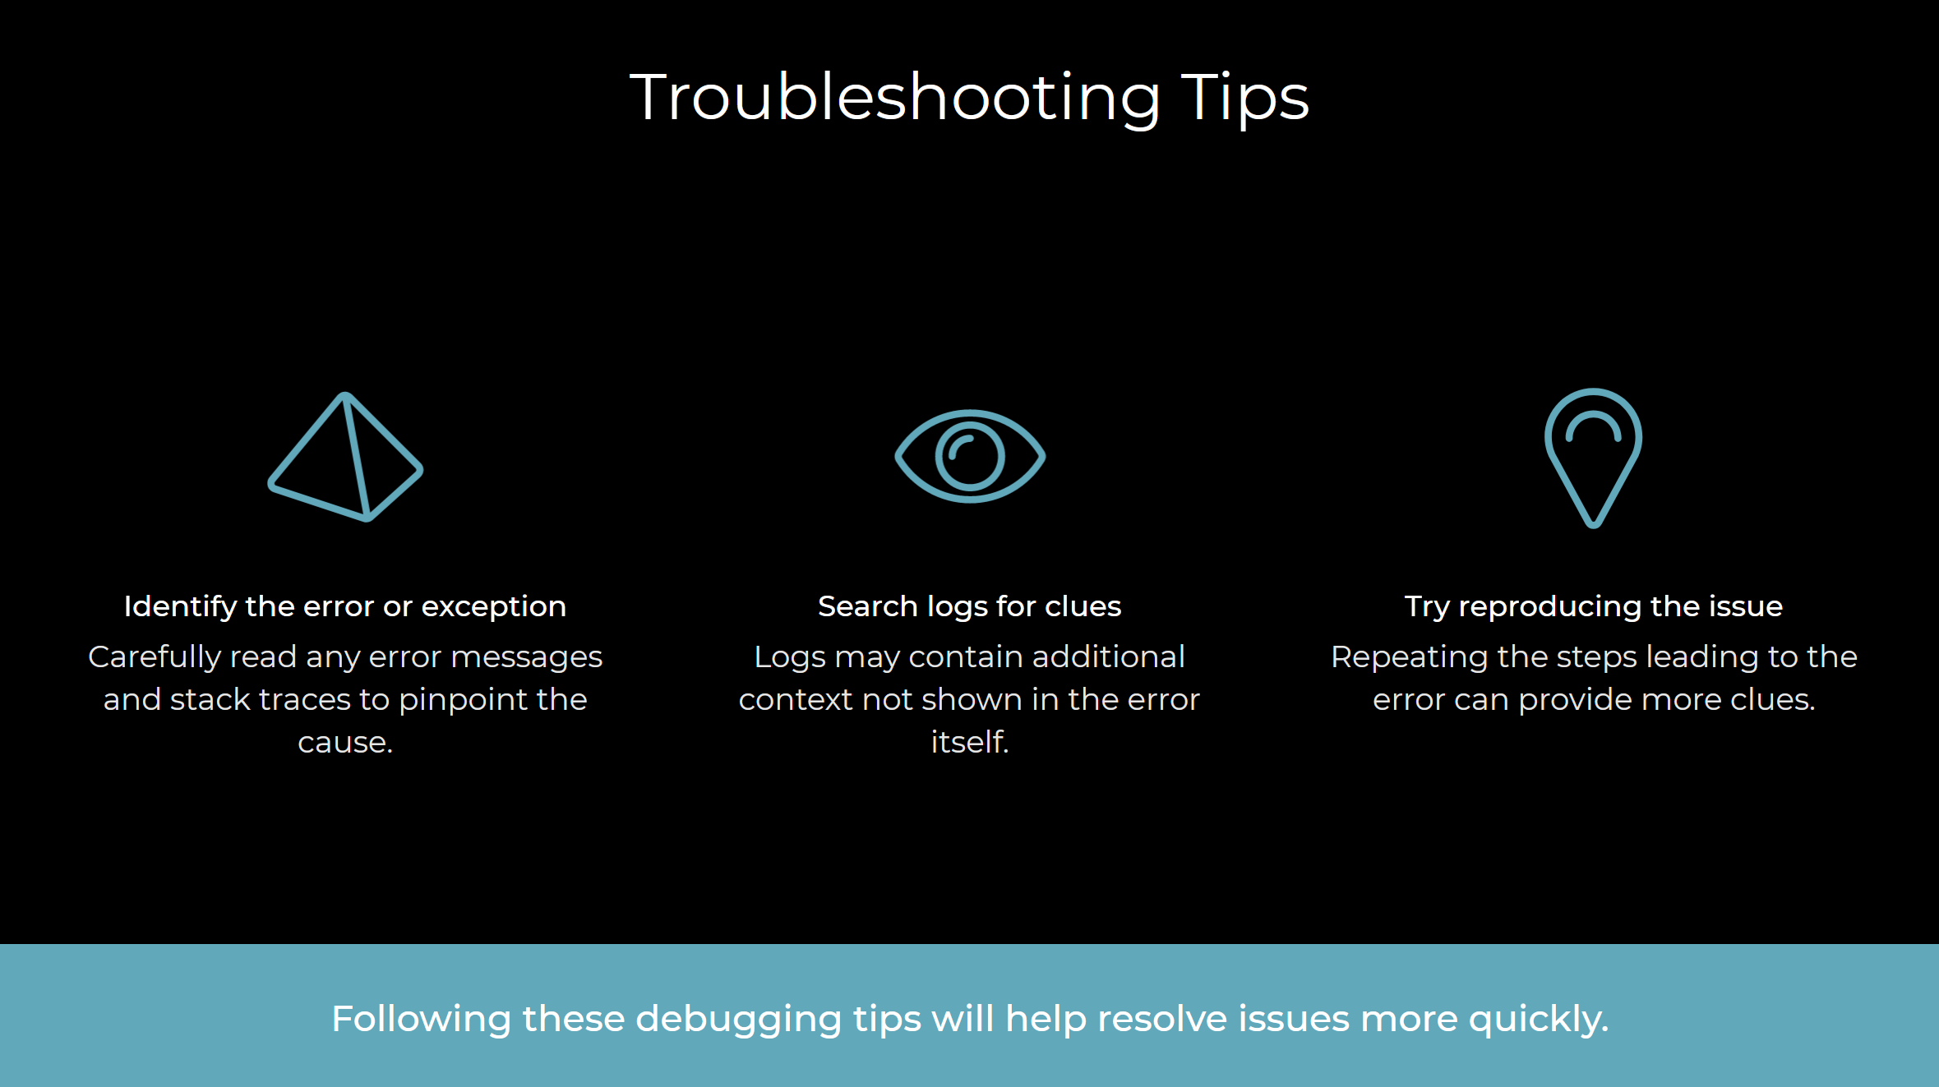

Slide 12
Implementation Considerations
Security
Permissions
Implement proper authentication and authorization to secure database access.
Carefully manage database permissions to provide least privilege access.
Multithreading
Gathering Results
Use multithreading to parallelize operations for performance gains.
Aggregate results from parallel operations and return consolidated output.

Slide 13

Happy because Parallel!

Slide 14
Thank YOU!
github.com/nanoDBA/demos
Notes:
Questions? Experiences?

